Slide 1
Introduction to GraphQL
Exploring the Evolution and Significance
Omkar Gavali

Slide 2
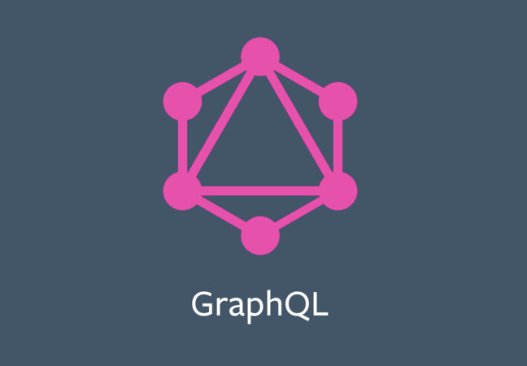
What is GraphQL?
GraphQL is an open-source data query language for APIs, and a runtime for executing those queries by using a type system you define for your data. It was developed by Facebook in 2012 and released as an open-source project in 2015.

Slide 3
History and Evolution
Timeline:
2012: Facebook initiates GraphQL internally.
2015: GraphQL is publicly released as an open-source project.
2017: GraphQL Foundation is established to govern the project.
2018: GraphQL becomes increasingly adopted by major tech companies.
Present: Widespread usage across various industries and domains.

Slide 4
Title: Why GraphQL?
Benefits:
Flexible data querying: Clients can request only the data they need.
Single endpoint: Simplifies API structure compared to REST.
Strongly typed schema: Ensures data consistency and validation.
Improved performance: Reduced data transfer and optimized queries.
Real-time capabilities: Support for subscriptions enables real-time updates.

Slide 5
Variables
Variables:
Variables in GraphQL are used to pass dynamic values into queries.
They allow you to reuse a single query with different input values.
Variables are defined separately from the query itself.
They are specified in the query as placeholders, prefixed with a dollar sign ($).
Example:
query GetPerson($id: ID!) {
person(id: $id) {
name
age
}
}
Here, $id is a variable placeholder, and ID! indicates it's a required ID.

Slide 6
Mutation
Mutations:
Mutations in GraphQL are used to modify data on the server.They allow you to reuse a single query with different input values.
They are like functions in REST APIs for creating, updating, or deleting data.
Mutations have a syntax similar to queries but are used to perform actions that cause changes on the server.
Example:
mutation AddPerson($name: String!, $age: Int!) {
addPerson(name: $name, age: $age) {
id
name
age
}
Here, addPerson is a mutation that takes name and age variables, and returns the newly created person's id, name, and age.
In short, variables enable dynamic values in queries, while mutations enable modifications of data on the server.

Slide 7
Title: Conclusion
GraphQL is a powerful data query language and runtime.
It offers flexibility, performance, and real-time capabilities.
Future Outlook: GraphQL continues to evolve and gain adoption in the industry.
Call to Action: Explore further and consider adopting GraphQL for your projects.

Slide 8
Thank You

